Slide 1
Technical Analysis
Feb. 07, 2017
Tian Run Yang, Cheng Zhou, Shiyuan Wu, Yida Wang, and Mengtian Ni

Slide 2
Presentation Outline
Technical Analysis definition
Indicators & Oscillators
Portfolio Composition
Portfolio performance comparison
Technical analysis vs. Fundamental analysis

Slide 3
What is Technical Analysis
Equity analysis methodology for forecasting the direction of prices using historic data, mostly based on price and volume
Price and volume reflects the collective behaviour of buyers and sellers
Assumptions:
market prices reflect both rational/irrational investor behaviour (efficient market hypothesis does not hold)
investor behaviour is reflected in trends and patterns will repeat and can be used to forecast prices

Slide 4

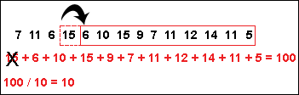
Price Indicators – Moving Average(MA)
'Moving Average-MA‘
Average of closing price over a specified period
Smooth out fluctuation of price data to form a trend following indicator
Define the current direction with a lag
Form the basis for many other indicators, such as Bollinger Bands, MACD
Commonly Used MAs
SMA( Simple Moving Average)
EMA (Exponential Moving Average)
gives bigger weight to more recent prices
Analytical Significance
It is an important analytical tool used to identify current price trends and the potential for a change in an established trend.
Single simple moving average compared to real price
Compare a pair of simple moving averages with each covering different time frames.
Notes:
References: Simple Moving Average - SMA Definition | Investopedia http://www.investopedia.com/terms/s/sma.asp
By Casey Murphy, Senior Analyst ChartAdvisor.com
A simple moving average is customizable in that it can be calculated for a different number of time periods, simply by adding the closing price of the security for a number of time periods and then dividing this total by the number of time periods, which gives the average price of the security over the time period. A simple moving average smoothes out volatility, and makes it easier to view the price trend of a security.

Slide 5
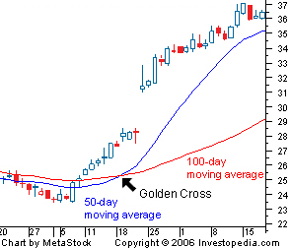
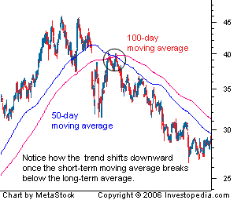
Price Indicator – Simple Moving Average（SMA）
Trading Strategies
Golden Cross
Death Cross
A security's short-term moving average breaks above its long-term moving average
A security's long-term moving average breaks above its short-term moving average
Notes:
Indicators are used in two main ways: to confirm price movement and the quality of chart patterns, and to form buy and sell signals.

Slide 6
Price Indicator – Simple Moving Average（SMA）
Matlab Demo
IBM 2015
Conclusion
Simple Moving averages are trend following, lagging
Chartists can use moving averages to define the overall trend and then use RSI to define overbought or oversold levels.
Notes:
http://finance.yahoo.com/quote/ibm/history?ltr=1
http://stockcharts.com/school/doku.php?id=chart_school:technical_indicators:moving_averages

Slide 7
Momentum Oscillators – Relative Strength Index
Ratio of total price increase to total price decrease over a selected number of periods
Oscillate from 0 ~ 100
>70 : Overbought – price is too high, and it is likely to decrease
<30: Oversold – price is too low, and it is likely to increase
Notes:
Reference: CFA Investments Chapter 12

Slide 8
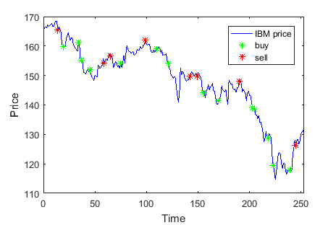
Momentum Oscillators – Relative Strength Index

Slide 9
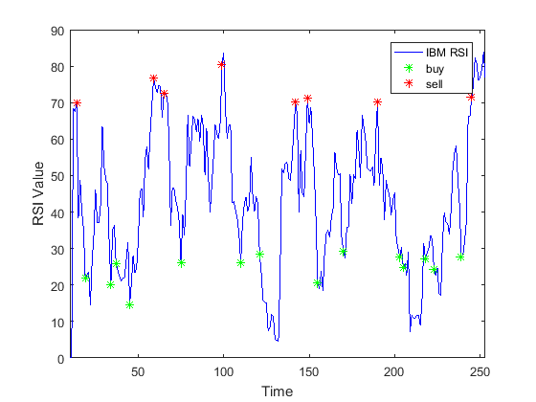
Single Stock Technical Analysis

Slide 10
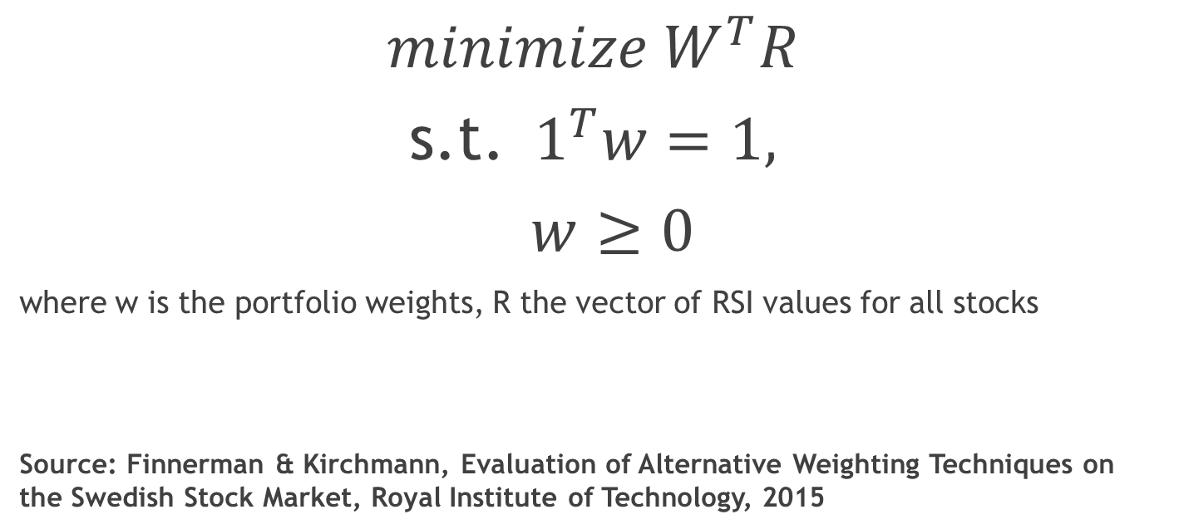
RSI Weighting
$$minimize W^{T}R$$
s.t. $1^{T}w=1,$
$w≥0$
where w is the portfolio weights, R the vector of RSI values for all stocks
Source: Finnerman & Kirchmann, Evaluation of Alternative Weighting Techniques on the Swedish Stock Market, Royal Institute of Technology, 2015

Slide 11
Fundamental Analysis VS Technical Analysis
 | Fundamental Analysis | Technical Analysis
Definition | Intrinsic (long-term) value of an asset | Price movement and patterns to predict future price movement
Data | Financial reports, news, industry statics | Share price & trading volume
Decision Making | Buy: price < intrinsic value Sell: price > intrinsic value | Buy: predict a price has a high probability moving to profit
Trader | Long term trading | Swing trader and short term day traders
Time Horizon | Days, weeks or even months | Days, minutes. Can be long term
Concepts | Report expectation vs. actual outcome Current news event vs. historical events | Trend lines, support & resistance, Dow Theory, price pattern

Slide 12
Comparison with Fundamental Analysis
Technical Analysis only uses trading volume and share prices
➔ not concerned with trader's reason for trading,
but only the trades that have occurred.
Advantage:
The data used (actual price & volume) is observable,
whereas fundamental is subject to estimates, assumptions and restatements,
and may not be available (i.e. currency & commodities)
Applied to the assets that don’t produce future cash flows (dividend and interest)
Financial statement fraud: price & volume reflect the true value of the company
Disadvantage:
Trading activity may be irrational
➔ can’t reflect the true supply & demand relationship
(i.e. illiquid markets and markets subject to outside manipulation)

Slide 13
Conclusion
We discussed technical analysis:
Simple Moving Average
Relative Strength Indicator
In depth look at RSI and portfolio optimization
Performance comparison between RSI balanced portfolio, equal weighted portfolio and SP500
Comparison of technical analysis and fundamental analysis

Slide 14

Q & A

Slide 15

Thank you!

